Slide 1
Principles of Economics
Final term
Topic 1: Measuring National Income - GDP

Slide 2
Objectives and Instruments of Macroeconomics
Objectives:
Output: High level and rapid growth of output
Employment: High level of employment with involuntary unemployment
Price-level stability

Slide 3
Instruments of Macroeconomics
Instruments
Monetary policy:
Controlling the money supply to determine the interest rates
Fiscal Policy:
Government expenditure
Taxation

Slide 4
Measuring National Income
Three main statistics of macroeconomics:
1. GDP—Gross domestic product, which tells us the nation’s total income and the total expenditure on its output of goods and services
2. CPI—the Consumer Price Index, which measures the level of prices (inflation)
3. Unemployment rate —this tells the fraction of workers who are unemployed.

Slide 5
Economic Models
Economists use models to simplify reality in order to improve our understanding of the world.
The most basic macroeconomic model include:
  The Circular Flow Diagram

Slide 6

Figure 1 The Circular-Flow Diagram
MARKETS
Revenue
FOR
Spending
GOODS AND SERVICES
Goods
Firms sell
Goods and
and services
Households buy
services
sold
bought
FIRMS
HOUSEHOLDS
Produce and sell
Buy and consume
goods and services
goods and services
Hire and use factors
Own and sell factors
of production
of production
Factors of
MARKETS
Labor, land,
production
FOR
and capital
FACTORS OF PRODUCTION
Wages, rent,
Households sell
Income
and profit
Firms buy
= Flow of inputs
and outputs
= Flow of money
Copyright © 2004 South-Western

Slide 7
The Circular-Flow Diagram
The circular-flow diagram is a visual model of the economy that shows how money flow through markets among households and firms.

Slide 8
THE MEASUREMENT OF GROSS DOMESTIC PRODUCT
Gross domestic product (GDP) is a measure of the income and expenditures of an economy.

Slide 9
THE MEASUREMENT OF GROSS DOMESTIC PRODUCT
GDP is the market value of all final goods and services produced within a country in a given period of time.

Slide 10
THE MEASUREMENT OF GROSS DOMESTIC PRODUCT
“GDP is the Market Value . . .”
  Output is valued at market prices.
“. . . Of All Final . . .”
  It records only the value of final goods, not intermediate goods (the value is counted only once).
  Hallmark Card: Paper is an intermediate good.
“. . . Goods and Services . . . “
  It includes both tangible goods (food, clothing, cars) and intangible services (haircuts, housecleaning, doctor visits).

Slide 11
THE MEASUREMENT OF GROSS DOMESTIC PRODUCT
“. . . Produced . . .”
  It includes goods and services currently produced, not transactions involving goods produced in the past.
“ . . . Within a Country . . .”
  It measures the value of production within the geographic confines of a country.

Slide 12
THE MEASUREMENT OF GROSS DOMESTIC PRODUCT
“. . . In a Given Period of Time.”
  It measures the value of production that takes place within a specific interval of time, usually a year or a quarter.
GDP includes all items produced in the economy and sold legally in markets.

Slide 13
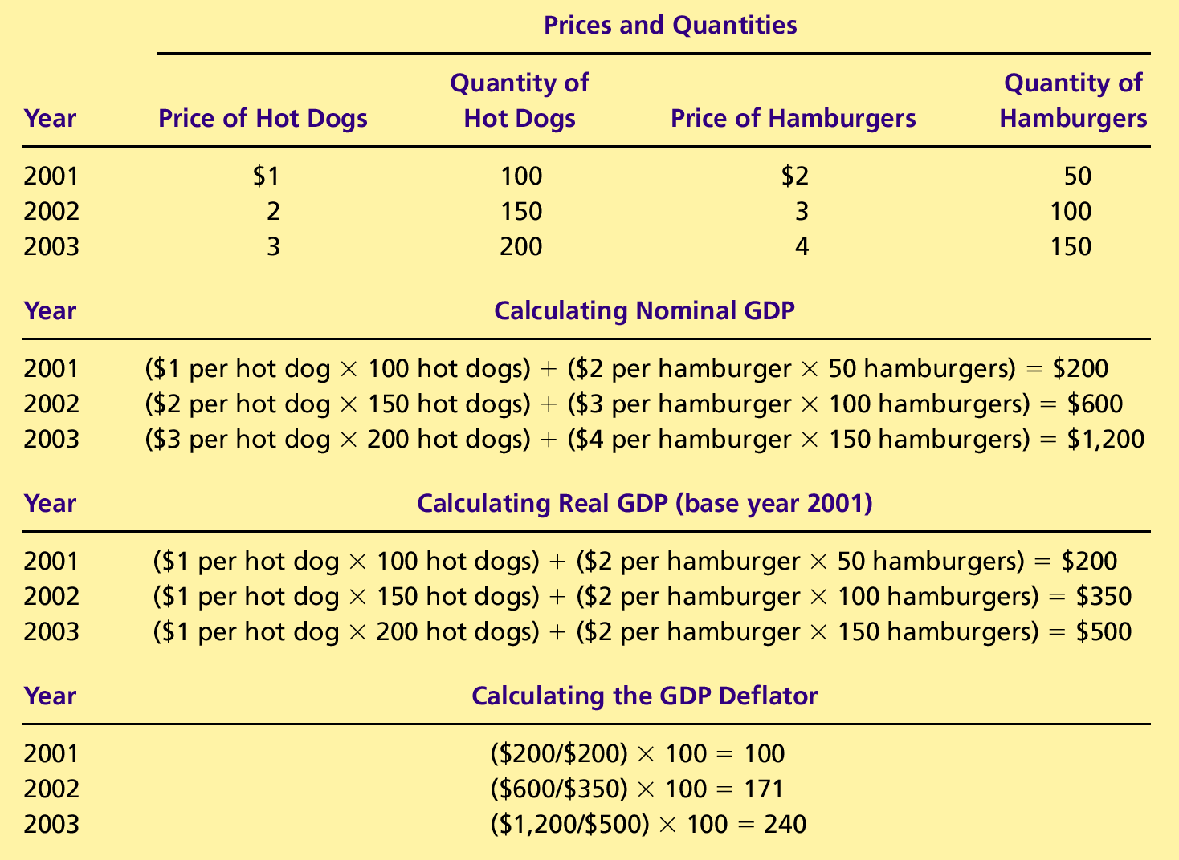
REAL VERSUS NOMINAL GDP
Nominal GDP values the production of goods and services at current prices.

Slide 14
REAL VERSUS NOMINAL GDP
Real GDP values the production of goods and services at constant prices.

Slide 15
Not Counted in GDP
What Is Not Counted in GDP?
  GDP excludes most items that are produced and consumed at home and that never enter the marketplace.
  It excludes items produced and sold illicitly, such as illegal drugs.

Slide 16
THE COMPONENTS OF GDP
GDP (Y) is the sum of the following:
  Consumption (C)
  Investment (I)
  Government Purchases (G)
  Net Exports (NX)
Y = C + I + G + NX

Slide 17
THE COMPONENTS OF GDP
Consumption (C):
  The spending by households on goods and services, with the exception of purchases of new housing.
Investment (I):
  The spending on capital equipment, inventories, and structures, including new housing.

Slide 18
THE COMPONENTS OF GDP
Government Purchases (G):
  The spending on goods and services by local, state, and federal governments.
  Does not include transfer payments because they are not made in exchange for currently produced goods or services.
Net Exports (NX):
  Exports minus imports.

Slide 19
GDP & Components of Expenditure
GDP Consumption Nondurable goods Durable goods Services Investment Nonresidential fixed investment Residential fixed investment | Government Purchases Defense Non-defense Net Export Export Import

Slide 20
GDP deflator
GDP deflator comes from nominal and real GDP
GDP deflator : Nominal GDP/Real GDP *100
With GDP deflator we can also measure the difference in price levels of good and services in a country at a given timeframe

Slide 21
GDP AND ECONOMIC WELL-BEING
GDP is the best single measure of the economic well-being of a society.
GDP per person tells us the income and expenditure of the average person in the economy.
Higher GDP per person indicates a higher standard of living.

Slide 22
GDP AND ECONOMIC
WELL-BEING
GDP is not a perfect measure.
Some things that contribute to well-being are not included in GDP.
  The value of leisure.
  The value of a clean environment.
  The value of almost all activity that takes place outside of markets, such as the value of the time parents spend with their children and the value of volunteer work.

Slide 23
Summary
Because every transaction has a buyer and a seller, the total expenditure in the economy must equal the total income in the economy.
Gross Domestic Product (GDP) measures an economy’s total expenditure on newly produced goods and services and the total income earned from the production of these goods and services.

Slide 24
Summary
GDP is the market value of all final goods and services produced within a country in a given period of time.
GDP is divided among four components of expenditure: consumption, investment, government purchases, and net exports.

Slide 25
Summary
Nominal GDP uses current prices to value the economy’s production. Real GDP uses constant base-year prices to value the economy’s production of goods and services.

Slide 26
Summary
GDP is a good measure of economic well-being because people prefer higher to lower incomes.
It is not a perfect measure of well-being because some things, such as leisure time and a clean environment, aren’t measured by GDP.

